Slide 1
#1: Allegory

Slide 2
Allegory Definitions
Write Down The 2 That Make The Most Sense To You
A story in which people, things, and happenings have a hidden or symbolic meaning: allegories are used for teaching or explaining ideas, moral principles, etc.
A narrative (that means story) in which characters and action represent concepts different from the literal meaning of the story.
Extending a metaphor (comparison) through an entire speech, passage or story so that objects, persons, and actions in the text are equated with meanings that lie outside the text.
A story with both a literal and symbolic meaning (characters, events or things in the story represent something else)
An allegory is a fictional story that refers to a real life situation using metaphors (comparisons).
a story in which the characters and events are symbols that stand for ideas about human life or for a political or historical situation

Slide 3
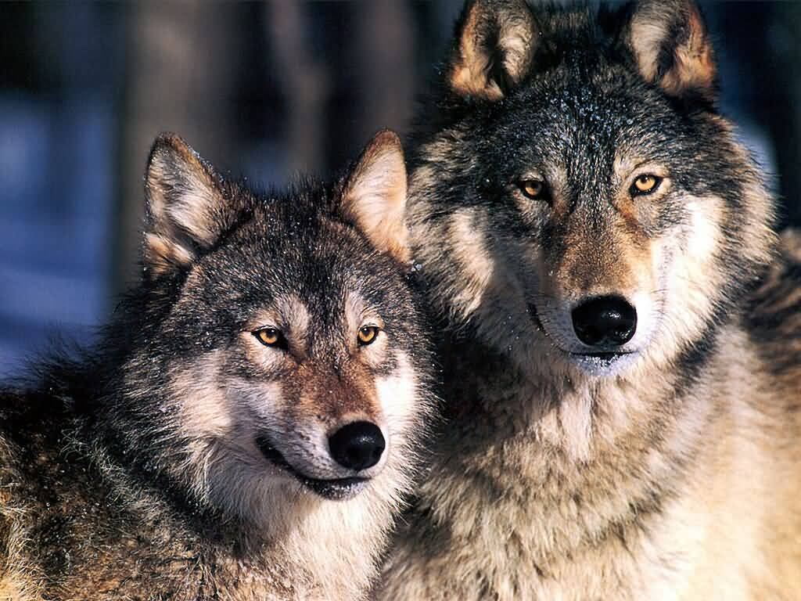
Allegory Example #1:
TWO WOLVES
One evening an old Cherokee told his grandson about a battle that goes on inside people.
He said, "My son, the battle is between two wolves inside us all.

Slide 4
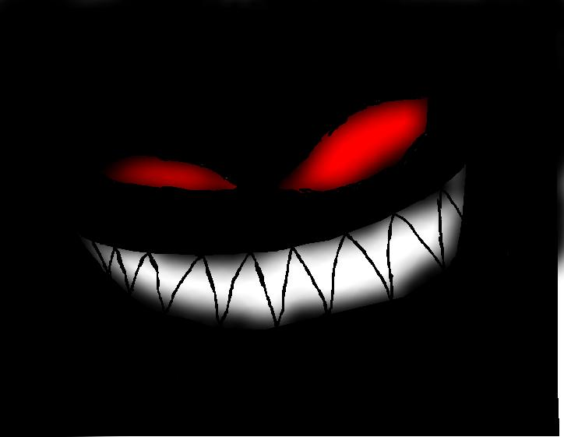
One is evil. It is anger, envy, jealousy, sorrow, regret, greed, arrogance, self-pity, guilt, resentment, inferiority, lies, false pride, superiority, and ego.

Slide 5
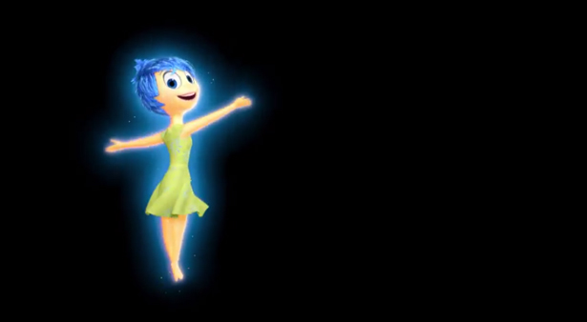
The other is good. It is joy, peace, love, hope, serenity, humility, kindness, benevolence, empathy, generosity, truth, compassion, and faith."

Slide 6
The grandson thought about it for a minute and then asked his grandfather, "Which wolf wins?"

Slide 7
The old Cherokee simply replied,
"The one you feed."

Slide 8
How is the story of the two wolves an allegory?

Slide 9
The story is an allegory because
The story is not about wolves….at all.
Wolf #1= is anger, envy, jealousy, sorrow, regret, greed, arrogance, self-pity, guilt, resentment, inferiority, lies, false pride, superiority, and ego
Wolf #2= joy, peace, love, hope, serenity, humility, kindness, benevolence, empathy, generosity, truth, compassion, and faith
What lesson is learned?
Who we are is a CHOICE.

Slide 10
Aesop's fables are examples of simple allegories, such as:
The Ant and the Grasshopper - the grasshopper fails to provide for the winter while wasting time mocking the ant.
The Dog and his Shadow - where the dog sees his reflection in a stream, and thinks the "other dog" has a larger piece of meat. He drops the one he's holding to grab it, and loses the meat in the water.

Slide 11
The Tortoise and the Hare
The story of the tortoise and the hare is an allegory, expressing the belief that the slow and steady will always defeat the quick and prideful in the end. In Aesop’s popular fable two different distinct personality types compete, with the winner living slow and stable over the loser’s fast and impetuous lifestyle.

Slide 12
The Tortoise and the Hare continued…
The hare has often been linked to youthful virility and physical vitality. The tortoise, on the other hand, is linked to age and tiredness. Two anthropomorphized creatures (animals given human qualities) compete for superiority, with the tortoise victor awarded fame, while the loser hare stews in his own disgrace, having failed to heed his elder's wisdom on matters of effective racing strategies.

Slide 13
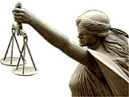
The blindfolded figure with scales is an allegory of justice.

Slide 14
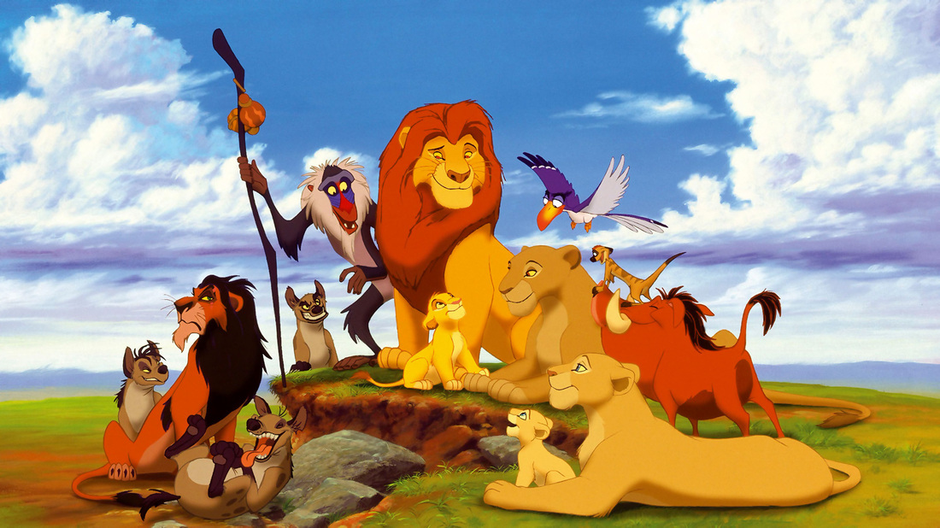
Any number of Disney's animated films or others made by Dreamworks and other production companies where animals or robots or even toys are depicted in a figurative way that is parallel to human behavior. For example, The Lion King, which tells a tale of young lion cub who is forced to grow into adulthood early because of circumstances that force him to deal with life in an adult way. Disney has touted this film as being the first animated film that Disney has made that is not based on a story by someone else and claim it is an original story.

Slide 15
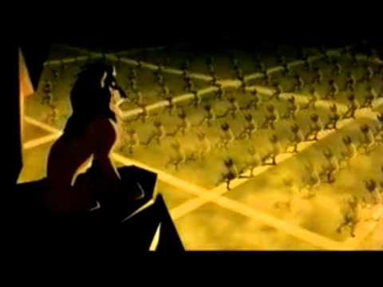
Perhaps the writers and producers and studio executives have never seen or heard of William Shakespeare's Hamlet, but The Lion King is remarkably similar to Hamlet where Simba parallels Hamlet, the evil Uncle Scar parallels Caudius and Simbas mother, of course, parallels Hamlet's mother. The only striking difference between these two stories is in Hamlet practically everybody dies but not so in the Lion King,, and Simba lives happily ever after with Hamlet's parallel of Ophelia.
What is this picture an
allegory for?

Slide 16
#2 Alliteration

Slide 17
Alliteration Definition:
Alliteration is a form of figurative language when a group of words has the same beginning sound.

Slide 18
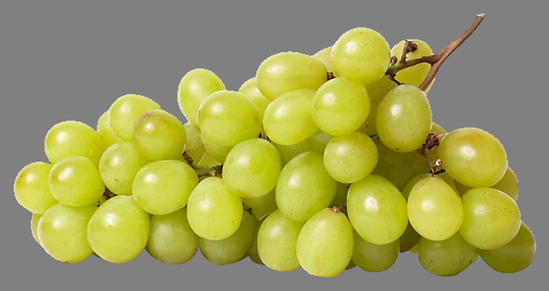
Greg gave Gretta grapes from grandma’s.

Slide 19
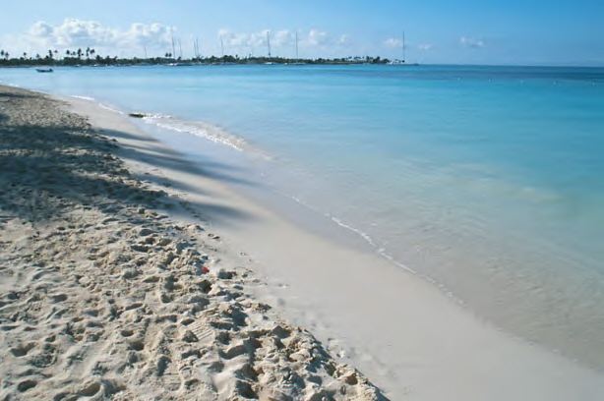
Sallie Sue sang songs to Susie on the seashore.

Slide 20
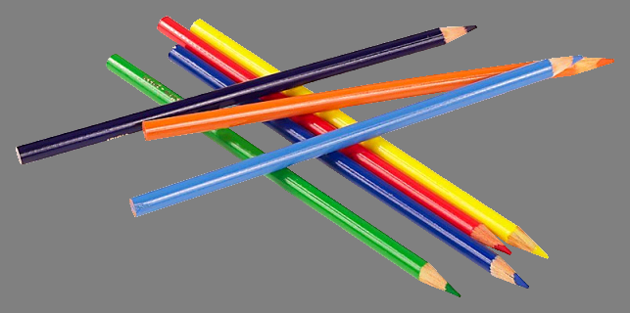
Peter paid Pedro five pesos for the pencils.

Slide 21
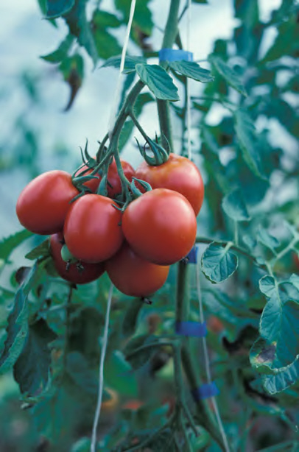
Tanya took ten tomatoes to Tito on Tuesday.

Slide 22
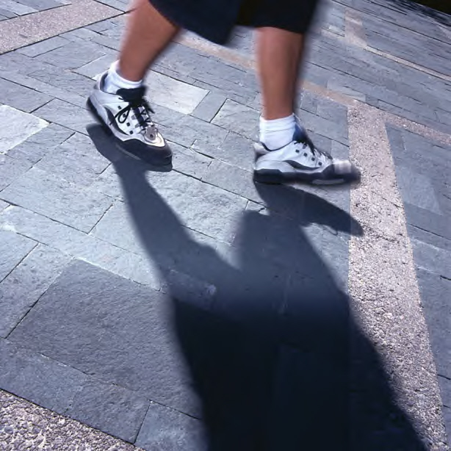
Lacey Lui loved her lucky laces.

Slide 23
Which of the following sentences is an example of alliteration?
A. Harry the Hamster was having a happy dream in his hamster house.
B. Katie was as beautiful as a rose.
C. I was so excited when I heard the “ding-dong” of the bell.

Slide 24
Which of the following sentences is an example of alliteration?
A. Harry the Hamster was having a happy dream in his hamster house.
B. Katie was as beautiful as a rose.
C. I was so excited when I heard the “ding-dong” of the bell.

Slide 25
Which of the following sentences is an example of alliteration?
A. Juan was as quick as a cricket when he ran in the race.
B. Frankie the Fish ate supper with Yertle the Turtle.
C. Queen Quincy was quite quiet when Quantel quit quickly.

Slide 26
Which of the following sentences is an example of alliteration?
A. Juan was as quick as a cricket when he ran in the race.
B. Frankie the Fish ate supper with Yertle the Turtle.
C. Queen Quincy was quite quiet when Quantel quit quickly.

Slide 27
Which of the following sentences is an example of alliteration?
A. Wayne slept like a log because he was so tired from his trip.
B. Trevor tried to trade his truck with Troy.
C. It was raining cats and dogs when we walked outside to go home.

Slide 28
Which of the following sentences is an example of alliteration?
A. Wayne slept like a log because he was so tired from his trip.
B. Trevor tried to trade his truck with Troy.
C. It was raining cats and dogs when we walked outside to go home.

Slide 29
#3 Allusions

Slide 30
Allusion Definition:
Definition-a reference within a work to something famous outside it, such as a well-known person, place, event, story, or work of art, literature, music, pop culture.

Slide 31
Why do authors use allusions?
Purpose-Lets reader/viewer understand new information, characters, plot, setting, etc. by connecting it to something already known.

Slide 32
Allusion “Problems”
Not to be confused with “ILLUSIONS”
In order to understand allusions, one must have a good grasp on “well-known” works of literature, art, music, pop culture, etc.
So, if one is not well-read, it will be difficult to fully grasp why an author/writer/director uses an allusion. This sometimes makes them difficult for high school students to grasp.

Slide 33
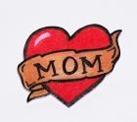

Allusion “Problems”
Allusions are NOT references to someone/something only a small group of people know.
  So, you wouldn’t say, “Sally’s smile looked like my mom’s smile.”
  While this is a method of comparison, it is not to something well-known (outside of your community).
=

Slide 34
Purpose of Allusions
Whenever you come across an allusion, stop and ask yourself:
  What does the writer want me to understand about this character, setting, plot, etc. by connecting it to something with which I am already familiar?
  What is the author’s purpose in using this allusion?
    To create the same feeling/mood as the original work?
    For comedic effect?
    To show character’s motives or traits?

Slide 35
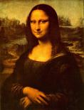
Allusion Examples
Sally had a smile rivaled only by that of the Mona Lisa.
Since everyone is familiar with the painting, they can imagine Sally’s almost expressionless smile.
What does this show about Sally?

Slide 36
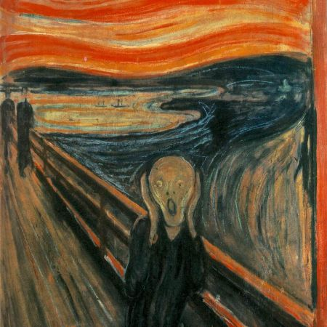
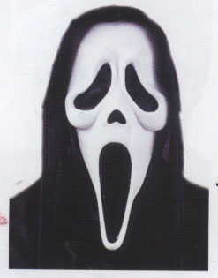
Allusion Example (Art to Film)
The makers of the Scream movie ALLUDED TO Munch’s work of art “The Scream” in order to instill fear.

Slide 37
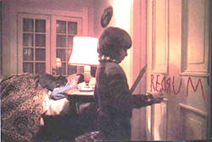

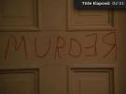
Allusions Example (TV to Film)
FAMILY GUY
THE SHINING
Danny writes “REDRUM” on the door at first.
Mirror reflection shows “Redrum”=
Murder backwards

Slide 38
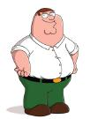
Family Guy/The Shining
The makers of Family Guy make Stewie’s blocks say “REDRUM” as an ALLUSION TO The Shining. They use this allusion because they know their audience will likely be familiar with The Shining, so they will understand the message that Stewie is obsessed with murder. REDRUM=MURDER backwards….as reflected in the mirror in The Shining.
This allusion helps the viewer gain a deeper understanding of Stewie’s character—a matricidal maniac!

Slide 39
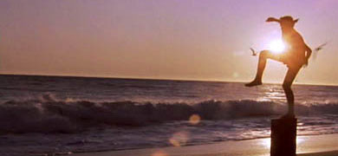
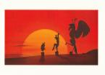
Allusions Example (Film to Film)
KARATE KID
DISNEY’S HERCULES
Hercules ALLUDES TO Karate Kid when Hercules is training. Disney uses this allusion so the viewer thinks of Karate Kid and how, after training in the sunlight, Daniel wins the big match. The allusion is used to FORESHADOW that Hercules will also be successful in his big fight.

Slide 40

Allusion Example (Poem to Book)
John Steinbeck’s Of Mice and Men book title alludes to Robert Burns’ poem “To a Mouse”
Burns’ poem lines:
  The best laid schemes of mice and men
  often go awry
  (Standard English Version)
Reason for allusion:
  Steinbeck is trying to send the message, through his title, that things will not go as the characters planned. It foreshadows a not-so-happy ending in which dreams are dashed.

Slide 41
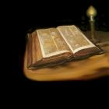
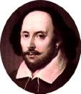
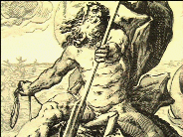
Most Popular Allusions
THREE MOST POPULARLY ALLUDED WORKS:
  The Bible
  Shakespeare
  Greek/Roman Mythology
  So, what does that tell you?
  ---You are expected to be well-read in order to understand many allusions!
POSEIDON,
God of Sea

Slide 42
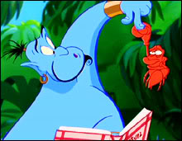
Shakespeare Allusion (Movie to Play)
“Et tu, Brute”
  Latin for “And you, Brutus”
  Said by Julius Caesar in Shakespeare’s play when he is about to die and realizes Brutus has betrayed him.
  Used when people want to get the message across that someone has betrayed them
In the scene in Aladdin where Genie is trying to make Aladdin a prince, he opens his recipe book. After the crab bites him, a robed hand comes out of the book, to which Genie says, “Et tu, Brute?” indicating that the recipe book has betrayed him, also, along with the crab. The purpose in this case, of course, is for comedic effect.

Slide 43
Romeo and Juliet Song Allusions
* Arctic Monkeys' song 'I Bet You Look Good on the Dancefloor contains the lyrics 'Oh there ain't no love no, Montagues or Capulets/Just banging tunes in DJ sets’
* Madonna's “Cherish” has a line that says "Romeo and Juliet, they never felt this way, I bet.“
* Dire Straits' 1980 popular song "Romeo and Juliet" in which the singer looks back on a failed relationship.
* The Delta Goodrem song "I Don't Care" contains the lyrics "they tried to keep Romeo and Juliet apart...”
* The Blue Öyster Cult song "(Don't Fear) The Reaper" mentions Romeo and Juliet as being "Together in eternity".
* The song Ampersand by The Dresden Dolls, features the lines "and I may be romantic, and I may risk my life for it/but I ain't gonna die for you/you know I ain't no Juliet.“
* The band Genesis uses the names Romeo and Juliet for characters in the song 'The Cinema Show'
* The Big Audio Dynamite has in the song "The Bottom Line" a reference to Romeo (as well as a reference to the famous soliloquy in Hamlet).

Slide 44
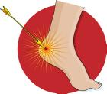
Mythology Allusions
Achilles’ Heel
  Original Tale-When Achilles was a baby, it was foretold that he would die in battle from an arrow. Naturally, his mother Thetis did not want her son to die. So she took Achilles to a magical river which was supposed to offer powers of invincibility and dipped his body into the water. But as Thetis had held Achilles by the heel, his heel was not washed over by the water of the magical river. Achilles grew up to be a man of war who survived many great battles. But one day, an arrow shot at him was lodged in his heel, killing him instantly. Yet Achilles is remembered as one of the greatest fighters who ever lived.
When someone wants to discuss one’s weak point, s/he will refer to it as his/her “Achilles’ Heel,” meaning that they are strong in all areas except for that one tiny spot.

Slide 45

Mythology Allusions
Advertising uses allusions, too!
Venus alludes to the mythological Roman goddess principally associated with love, beauty, and fertility.

Slide 46
#3 Ambiguity

Slide 47
Ambiguity Definition:
Doubtfulness or uncertainty of meaning or intention
An unclear, indefinite expression or meaning

Slide 48
Why do authors use ambiguity?
Although ambiguity is considered a flaw in writing, many writers use this technique to:
allow readers to understand their works in a variety of ways, giving them depth and complexity.
can humorous.
Challenges the reader
Let us analyze some ambiguity examples in literature.

Slide 49
Excerpt from Catcher in the Rye
“I ran all the way to the main gate, and then I waited a second till I got my breath. I have no wind, if you want to know the truth. I’m quite a heavy smoker, for one thing—that is, I used to be. They made me cut it out. Another thing, I grew six and a half inches last year. That’s also how I practically got t.b. and came out here for all these goddam checkups and stuff. I’m pretty healthy though.”

Slide 50
Explanation
The words “they” and “here” used by the speaker are ambiguous. But the readers are allowed to presume from the context that “they” might be the professionals helping out Holden and “here” might be a rehabilitation center.

Slide 51
Lewis Carroll’s Alice in Wonderland
The mouse says, “I have a long and sad tale.”
Alice responds that she can see that the mouse’s tail is long, but asks, “why do you call it sad?”
This is ambiguous in speech, but not in writing.

Slide 52
What is ambiguous about these sentences?
The girl skipped happily by the bank.
The man looked at the boy with the telescope.
The handsome man was wearing a light suit.
At the zoo, I saw the little boy duck.
Three-year-old teacher needed for preschool.

Slide 53
Ambiguity Practice
Look at the following pictures, and decide why they are ambiguous.

Slide 54
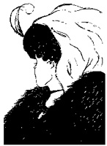

Slide 55


Slide 56
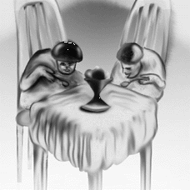

Slide 57
#4 Analogies

Slide 58
Analogy Definition:
An analogy is a comparison between two things, and the comparison is used to determine the relationship between different sets of things.
Bark is to dog as meow is to cat.

Slide 59
Many Different Types of Analogies
    Synonym to antonym: hot is to cold
    Part to whole: core is to apple
    Function to thing: cook is to stove
    Characteristic to thing: slippery is to ice
    Product to thing: milk is to cow

Slide 60
Guidelines to solve analogies
decide upon the relationship between first 2 words
state the relationship - car is to tire because___________
examine the third word – chair
select a fourth word that will make the third-fourth word have the same relationship as the first-second word
be ready to explain your fourth word selection
Car is to tire as chair is to ______.

Slide 61

Model and Practice
On is to off as start is to __________.
Nail is to finger as hair is to _________.
Eye is to see as ear is to ____________.
Swift is to deer as slow is to _________.
Wool is to sheep as egg is to _________.

Slide 62
Model and Practice
On is to off as start is to __________.
stop, opposites
Nail is to finger as hair is to _________.
head, part to whole
Eye is to see as ear is to ____________.
hear, thing to function
Swift is to deer as slow is to _________.
turtle, characteristic to thing
Wool is to sheep as egg is to _________.
chicken, product to thing

Slide 63
#5 Anaphora

Slide 64
Anaphora Definition:
An anaphora is the repeated use of a word or phrase in the beginning of a sentence or phrase. It can be used for emphasis, but it is also easy to overdo it, which ruins the effect of it.

Slide 65
"We saw the bruised children of these fathers clump onto our school bus, we saw the abandoned children huddle in the pews at church, we saw the stunned and battered mothers begging for help at our doors."
(Scott Russell Sanders, Under the Influence, 1989)

Slide 66
  “We shall not flag or fail. We shall go on to the end. We shall fight in France, we shall fight on the seas and oceans, we shall fight with growing confidence and growing strength in the air, we shall defend our island, whatever the cost may be, we shall fight on the beaches, we shall fight on the landing grounds, we shall fight in the fields and in the streets, we shall fight in the hills. We shall never surrender.”
  - Winston Churchill, World War II speech in House of Commons

Slide 67
Watch the following video. You can easily hear how anaphora is used even in political speeches.
https://www.youtube.com/watch?v=SMezcWFW8ss

