Slide 1
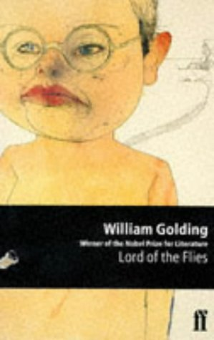
Lord of the Flies 1954
Introduction and Background

Slide 2
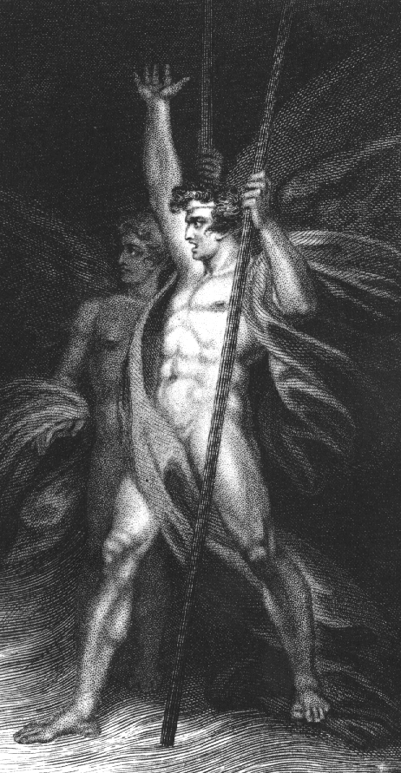
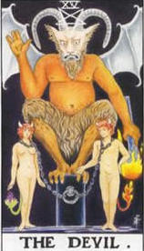
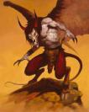
Title Translation
“Beelzebub” a Hebrew word for
LUCIFER
However, the literal translation of “Beelzebub”
into English is LORD OF THE FLIES

Slide 3
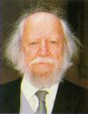
L.O.T.F Author
William Golding
Born in Britain
1911-1993

Slide 4
In the decade before LOTF was published, Britain had been involved in two wars:
WWII
Korean War

Slide 5
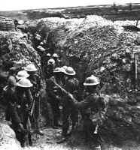
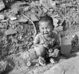
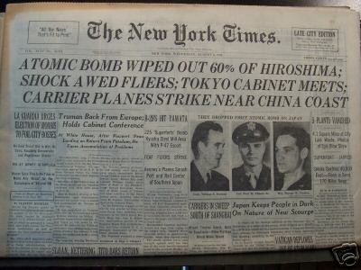
As a child, Golding had witnessed WWI, which was referred to as “the war to end all wars”
HOWEVER,
22 years later Britain was again involved in
ANOTHER WAR
to end all wars, which caused more devastation than was imaginable

Slide 6
Through LOTF, Golding is making the statement that we cannot escape our savage, violent tendencies…

Slide 7
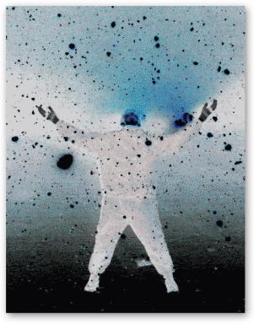
…and without social order, we devolve into a state of chaos

Slide 8
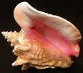
LOTF Symbols (Objects, characters, figures, or colors that represent ideas or concepts)
Piggy’s Glasses = The last surviving evidence of the lawful, structured world
Conch Shell = New democracy on the island
Snake = Evil…reference to the serpent in the garden of Eden

Slide 9
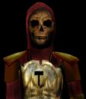
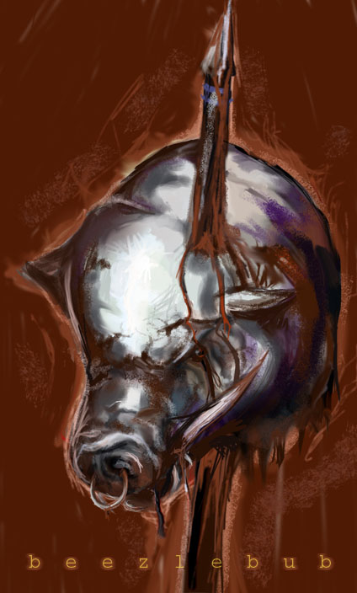
Important Images
The Beast = The imaginary evil that is projected onto the island by the boys’ paranoia
Lord of the Flies = A pig’s head on a stick that becomes the physical acceptance of evil on the island

Slide 10
TERMS to REMEMBER
Microcosm = A small world that represents the world at large
Edenic = Eden like, paradise like, a setting that has not yet been spoiled by man

Slide 11
Character Analysis
Ralph ~ Main character described as “fair haired,” having “broad shoulders…[like a] boxer’s,” and has a face that “proclaims no devil”
Committed to civilization and morality
Translation = GOOD

Slide 12
Character Analysis
Piggy \ Described as “fat,” “intellectual,” asthmatic, and needs glasses
Represents scientific, rational side of civilization, and social order

Slide 13
Character Analysis
Jack ~ Described as having red hair, wears black with a snake clasp, ugly
Cruel and manipulative
Represents our savage instincts played out
EVIL

Slide 14
Character Analysis
Simon ~ Described as a skinny, vivid little boy, who “meditates;” and he faints, which some cultures have believed is a sign of connecting with the spiritual world
Seems to be connected with nature, and he has an innate, spiritual goodness

Slide 15
Character Analysis
Roger ~ “Silent” and sadistic
Targets the “littluns”
The only one to premeditate murder
Kills without conscience
Pure evil

Slide 16
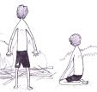
Character Analysis
Sam and Eric (Samneric) ~ Twins
Described as barely having enough skin to cover both, bullet-headed, and they finish each other’s sentences
The last to remain loyal to Ralph
Represent the tug-of-war
within us to remain good

Slide 17
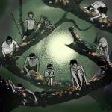
Character Analysis
“Littluns” ~ The younger kids
Represent the common folk, who easily follow the lead of others into savagery when there is no enforced structure in society

